Slide 1
Bank Security
Secure Cloud Transformation
Dave Ferguson
June 2023
Notes:
How are we ensuring consistency of security controls across cloud environments?

Slide 2






Strong Foundations
Clear Requirements
Secure Data Centres
Cyber Engagement
Roles and Responsibilities
Inventory and Ownership
Monitoring and Vulnerability Management
Notes:
We’ve worked long and hard to build strong processes and tooling to support our creation of infrastructure and applications on-premise. Multiple hosting sites, network segregation, BIA, BC, DR … all the things we need to support the UK.
Building infrastructure required some form filling and could take a long time, but everyone knew what we had to do.
Servers are created in existing, secure data centres using known standards and processes.
Cyber Security have clear touch points for engagement from secure architecture to DevOps practices. Tooling is in place for access management, security monitoring, concession approvals, and auditing.
Assets and systems have owners who are accountable and are provided with reports that communicate their posture management.
Security monitoring and vulnerability management is well established and effective.

Slide 3


Let’s All Go To The Cloud
Unclear Requirements
Cloud Resources & Configurations
Cyber Involvement
Unclear Roles & Responsibilities
Undefined Inventory and Ownership
Expensive Monitoring and Vulnerability Management
Notes:
The benefits of the cloud are well published, but difficult to appreciate. For young start-ups who can be agile and experimental can utilise Cloud Native Resources and capitalise on cost savings through SaaS and PaaS.
For the rest of us, our stakeholders want the Cloud but not the pain of adapting to the new way of working. Requirements stay the same, but start to increase to allow the Cloud Transformation to work. Lift-and-shift and IaaS allows us to move our existing responsibilities to the Cloud.
Without physical assets to manage and Infrastructure as Code, staff need training to support the new ways of creating resources in the cloud to avoid mis-configurations.
Cyber also needs to up-skill. With new horizons come new challenges. Phrases like Zero-Trust have become popular in an attempt to help secure our assets in the Cloud.
Roles and responsibilities can be unclear. If a user has the ability to spin up a VM in the Cloud, why should Infrastructure be accountable for monitoring and patching?
The ephemeral nature of the Cloud causes an issue with knowing what we have and what we need to care about.
Our monitoring and vulnerability management efforts also have new challenges and need support to identify and remediate issues in an environment where owners aren’t confident of the impact it may have.

Slide 4




We’re Gonna Need a Plan
Identify
What have we got?
Do we need all of these assets?
How do we track this going forward?
Organise
Who owns all these resources?
Where should we be creating new assets?
How can we charge this back?
Prioritise
There is so much to do, where do we start?
Are we securing the basics?
Do we have a roadmap?
Report
There are a lot of eyes on this, are we communicating?
What does “good” look like?
Notes:
Our Action
Identify
We can only protect what we know
Are native capabilities good enough
Organise
Our current structure is not effective
We need to understand the cost of the Cloud
Prioritise
Insights into issues need to be taken seriously
There is a lot of work to do, but there are always quick wins
Report
Doing all this work is worth nothing if we don’t shout about it

Slide 5
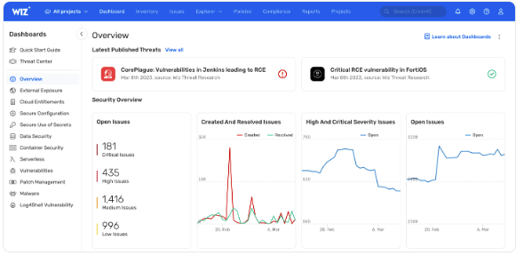
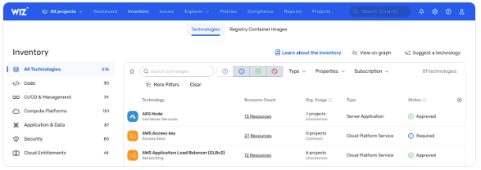
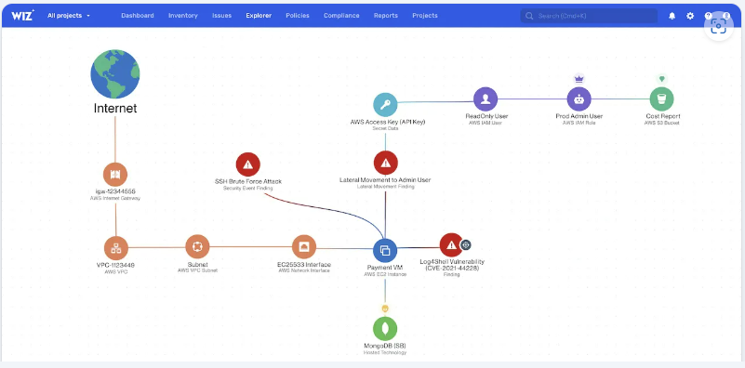
Tooling Helped Identify Actions – Wiz.io

Slide 6
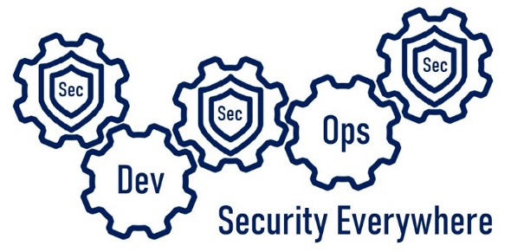
Questions?
Dave Ferguson

Slide 7

DevSecOpsVince

